Slide 1
COT5615: Math for Intelligent Systems I
Anand Rangarajan
Lecture 3

Slide 2

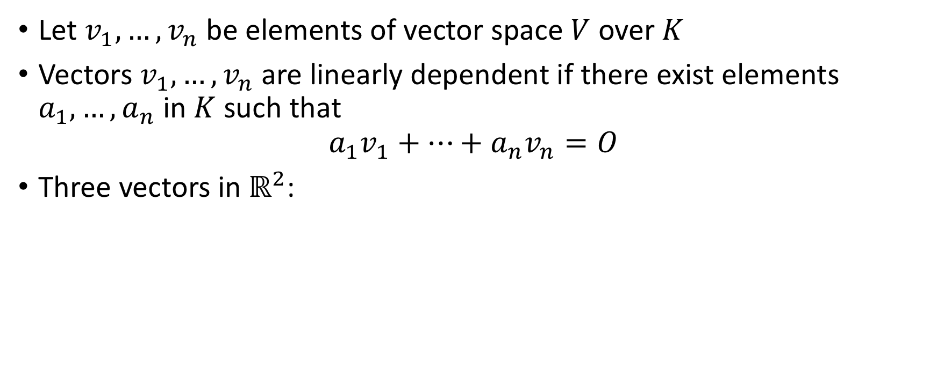
Bases
Let $v_{1},…,v_{n}$ be elements of vector space $V$ over $K$
Vectors $v_{1},…,v_{n}$ are linearly dependent if there exist elements $a_{1},…,a_{n}$ in $K$ such that
$$a_{1}v_{1}+…+a_{n}v_{n}=O$$
Three vectors in $ℝ^{2}$:
These three vectors in $ℝ^{2}$ cannot be linearly independent.
One of the vectors can be written in terms of the other two.

Slide 3

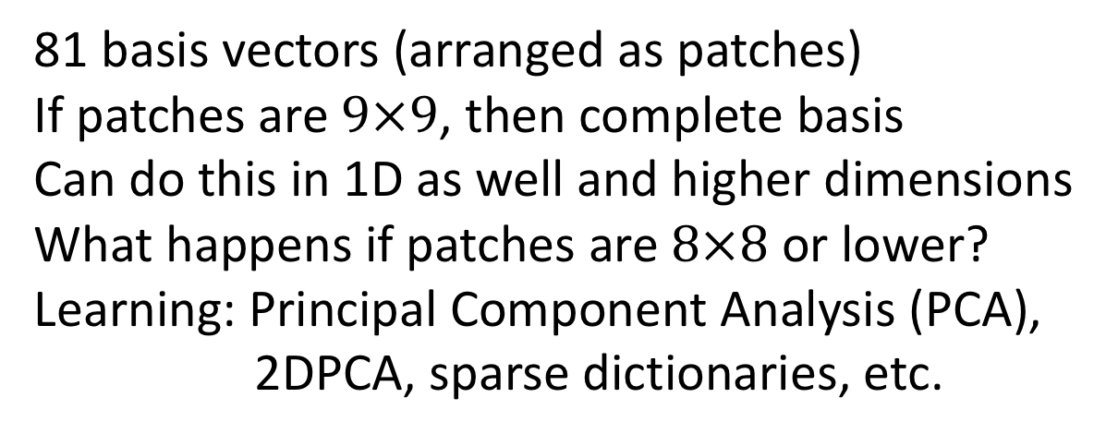
Relevance to machine learning
81 basis vectors (arranged as patches)
If patches are $9×9$, then complete basis
Can do this in 1D as well and higher dimensions
What happens if patches are $8×8$ or lower?
Learning: Principal Component Analysis (PCA),
2DPCA, sparse dictionaries, etc.

Slide 4
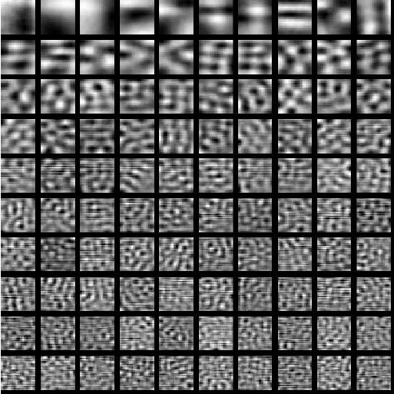
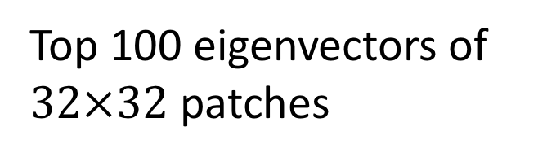
PCA of image patches
Top 100 eigenvectors of
$32×32$ patches

Slide 5
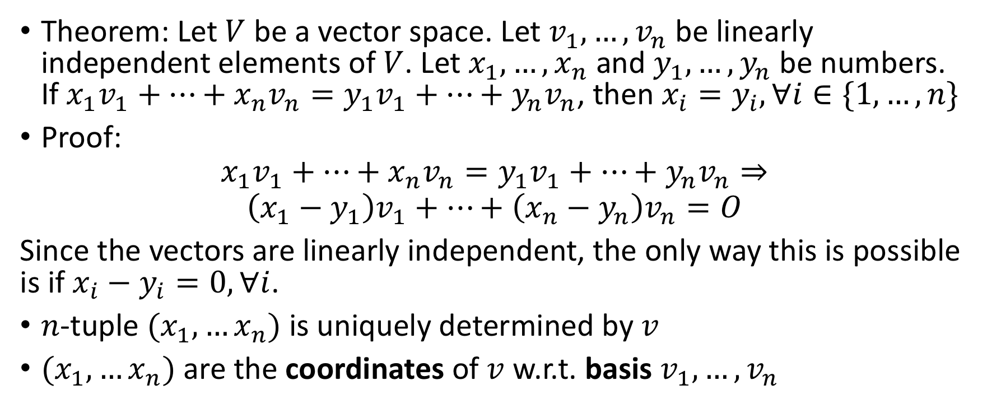
Basis and Coordinates
Theorem: Let $V$ be a vector space. Let $v_{1},…,v_{n}$ be linearly independent elements of $V$. Let $x_{1},…,x_{n}$ and $y_{1},…,y_{n}$ be numbers. If $x_{1}v_{1}+…+x_{n}v_{n}=y_{1}v_{1}+…+y_{n}v_{n}$, then $x_{i}=y_{i},∀i∈\{1,…,n\}$
Proof:
$$x_{1}v_{1}+…+x_{n}v_{n}=y_{1}v_{1}+…+y_{n}v_{n}⇒$$
$$\left(x_{1}−y_{1}\right)v_{1}+…+\left(x_{n}−y_{n}\right)v_{n}=O$$
Since the vectors are linearly independent, the only way this is possible is if $x_{i}−y_{i}=0,∀i$.
$n$-tuple $(x_{1},…x_{n})$ is uniquely determined by $v$
$(x_{1},…x_{n})$ are the coordinates of $v$ w.r.t. basis $v_{1},…,v_{n}$

Slide 6
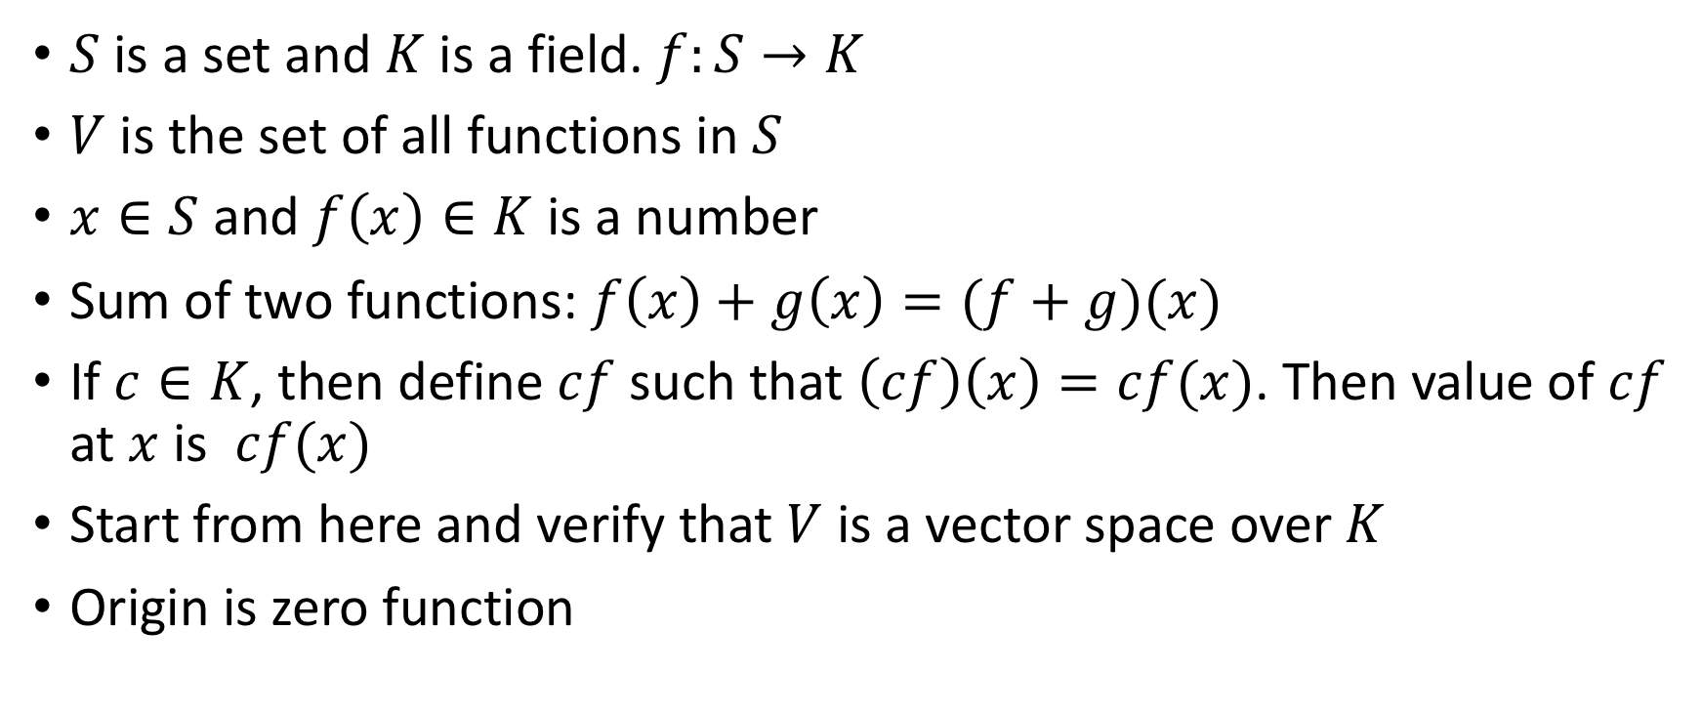
Function Spaces
$S$ is a set and $K$ is a field. $f:S→K$
$V$ is the set of all functions in $S$
$x∈S$ and $f\left(x\right)∈K$ is a number
Sum of two functions: $f\left(x\right)+g\left(x\right)=(f+g)(x)$
If $c∈K$, then define $cf$ such that $\left(cf\right)\left(x\right)=cf(x)$. Then value of $cf$ at $x$ is $cf(x)$
Start from here and verify that $V$ is a vector space over $K$
Origin is zero function

Slide 7
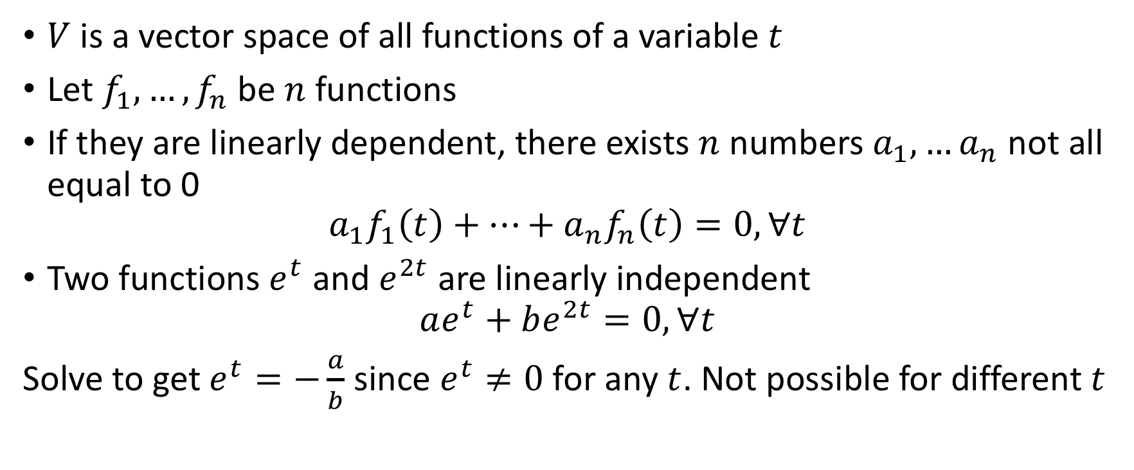
Example 2
$V$ is a vector space of all functions of a variable $t$
Let $f_{1},…,f_{n}$ be $n$ functions
If they are linearly dependent, there exists $n$ numbers $a_{1},…a_{n}$ not all equal to 0
$$a_{1}f_{1}\left(t\right)+…+a_{n}f_{n}\left(t\right)=0,∀t$$
Two functions $e^{t}$ and $e^{2t}$ are linearly independent
$$ae^{t}+be^{2t}=0,∀t$$
Solve to get $e^{t}=−\frac{a}{b}$ since $e^{t}≠0$ for any $t$. Not possible for different $t$

Slide 8
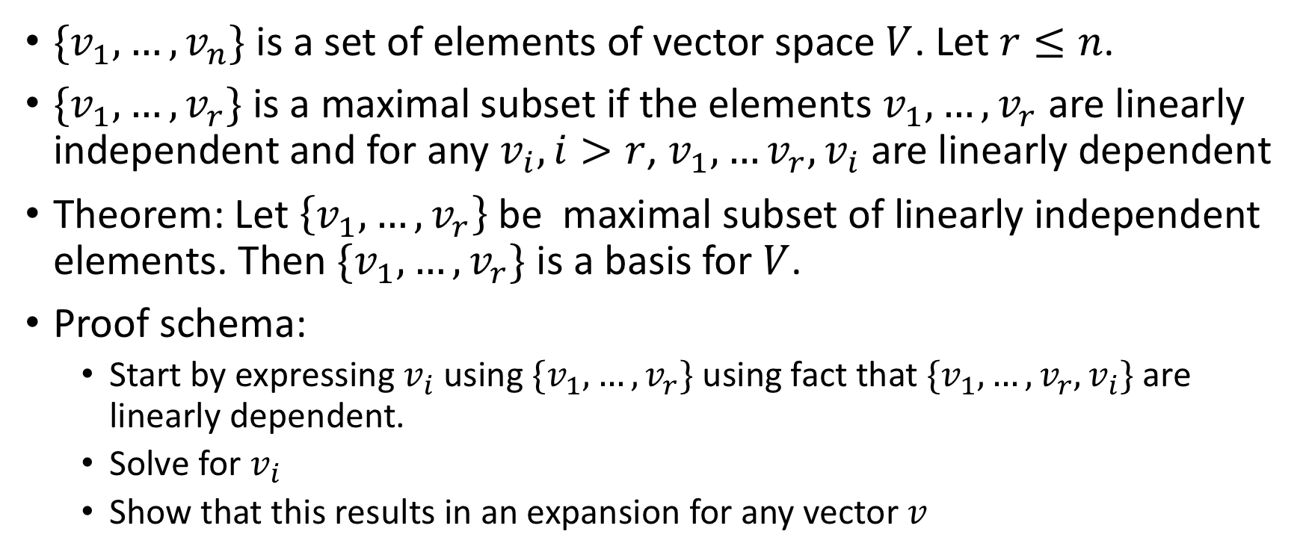
Basis and Maximal Subset
$\{v_{1},…,v_{n}\}$ is a set of elements of vector space $V$. Let $r≤n$.
$\{v_{1},…,v_{r}\}$ is a maximal subset if the elements $v_{1},…,v_{r}$ are linearly independent and for any $v_{i},i>r$, $v_{1},…v_{r},v_{i}$ are linearly dependent
Theorem: Let $\left\{v_{1},…,v_{r}\right\}$be maximal subset of linearly independent elements. Then $\{v_{1},…,v_{r}\}$ is a basis for $V$.
Proof schema:
Start by expressing $v_{i}$ using $\{v_{1},…,v_{r}\}$ using fact that $\{v_{1},…,v_{r},v_{i}\}$ are linearly dependent.
Solve for $v_{i}$
Show that this results in an expansion for any vector $v$

Slide 9
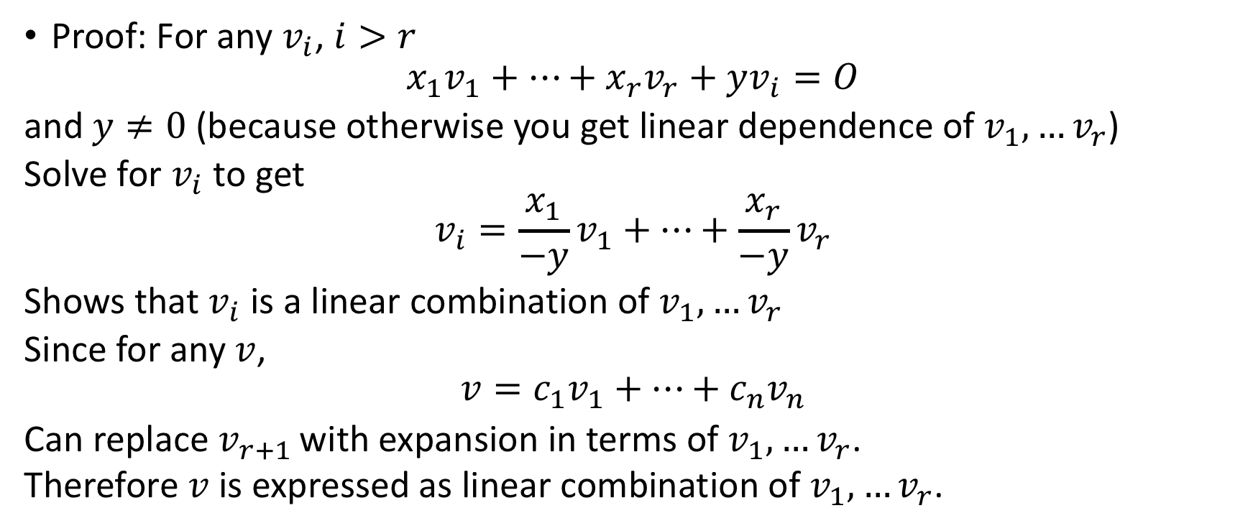
Basis and Maximal Subset (contd.)
Proof: For any $v_{i}$, $i>r$
$$x_{1}v_{1}+…+x_{r}v_{r}+yv_{i}=O$$
and $y≠0$ (because otherwise you get linear dependence of $v_{1},…v_{r}$)
Solve for $v_{i}$ to get
$$v_{i}=\frac{x_{1}}{−y}v_{1}+…+\frac{x_{r}}{−y}v_{r}$$
Shows that $v_{i}$ is a linear combination of $v_{1},…v_{r}$
Since for any $v$,
$$v=c_{1}v_{1}+…+c_{n}v_{n}$$
Can replace $v_{r+1 }$with expansion in terms of $v_{1},…v_{r}$.
Therefore $v$ is expressed as linear combination of $v_{1},…v_{r}$.

Slide 10
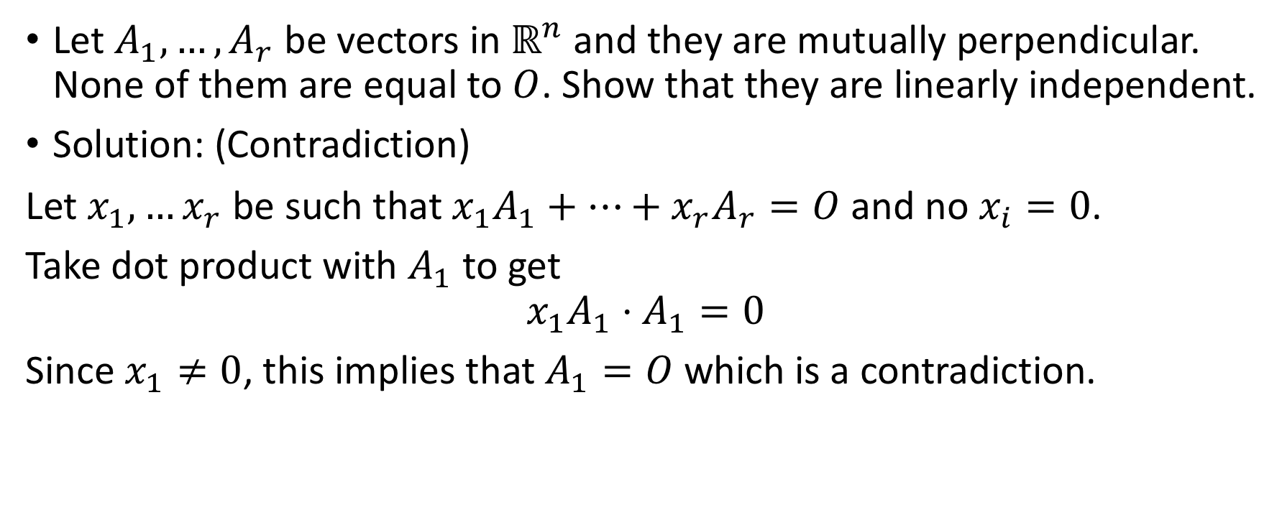
Problem 9
Let $A_{1},…,A_{r}$ be vectors in $ℝ^{n}$ and they are mutually perpendicular. None of them are equal to $O$. Show that they are linearly independent.
Solution: (Contradiction)
Let $x_{1},…x_{r}$ be such that $x_{1}A_{1}+…+x_{r}A_{r}=O$ and no $x_{i}=0$.
Take dot product with $A_{1}$ to get
$$x_{1}A_{1}⋅A_{1}=0$$
Since $x_{1}≠0$, this implies that $A_{1}=O$ which is a contradiction.

Slide 11
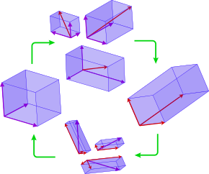
Introduction: Basis of a vector space
Multiple bases
Need not be mutually perpendicular
Have to be the same number

